Slide 1

8th Grade Math: Pre-Algebra
Unit 14, Lesson 8 Making Predictions Volume 2, pg. 349

Slide 2


Benchmarks
MA.8.DP.2.1
Determine the sample space for a repeated experiment.
MA.8.DP.2.2
Find the theoretical probability of an event related to a repeated experiment.
MA.8.DP.2.3
Solve real-world problems involving probabilities related to single or repeated experiments, including making predictions based on theoretical probability.
volume 2, pg. 349

Slide 3
Integrated Mathematical Thinking and Reasoning Standards
MA.K12.MTR.3.1 Complete tasks with mathematical fluency.
MA.K12.MTR.7.1 Apply mathematics to real-world contexts.
volume 2, pg. 349

Slide 4

Learning Target
I can use theoretical probability to make predictions.
volume 2, pg. 349

Slide 5

Warm-Up
volume 2, pg. 350

Slide 6
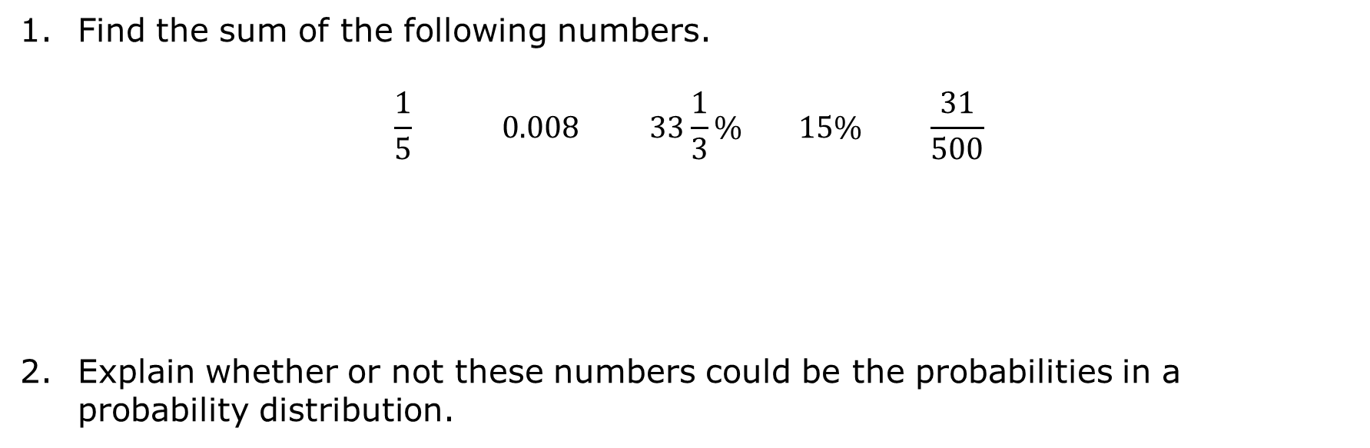
14.8.1 Warm-Up: Sum Probabilities
Find the sum of the following numbers.
$$\frac{1}{5} 0.008 33\frac{1}{3}\% 15\% \frac{31}{500}$$
Explain whether or not these numbers could be the probabilities in a probability distribution.
volume 2, pg. 350

Slide 7

Collaboration
volume 2, pg. 350

Slide 8


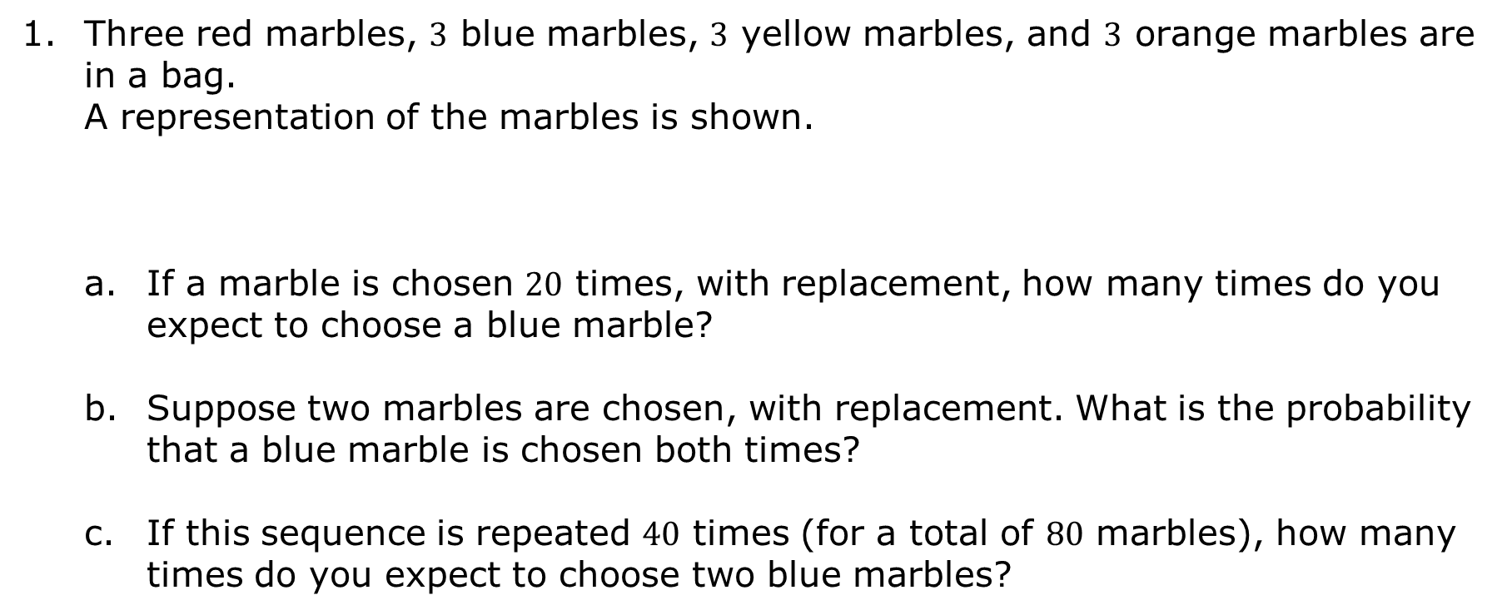
14.8.2 Collaboration: Solving Problems With Probability
Three red marbles, $3$ blue marbles, $3$ yellow marbles, and $3$ orange marbles are in a bag.
A representation of the marbles is shown.
If a marble is chosen $20$ times, with replacement, how many times do you expect to choose a blue marble?
Suppose two marbles are chosen, with replacement. What is the probability that a blue marble is chosen both times?
If this sequence is repeated $40$ times (for a total of $80$ marbles), how many times do you expect to choose two blue marbles?
volume 2, pg. 350

Slide 9
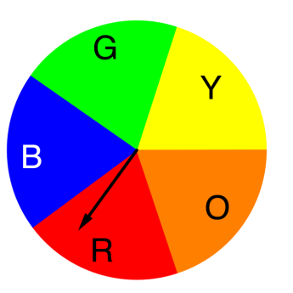
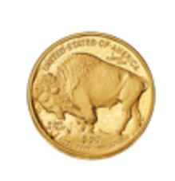
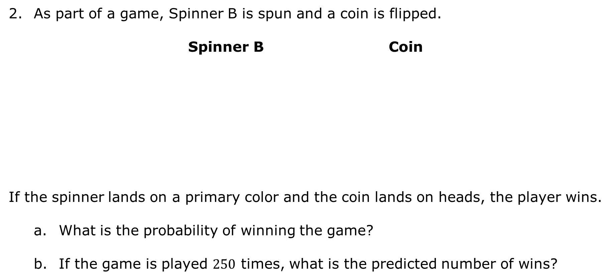
As part of a game, Spinner B is spun and a coin is flipped.
Spinner B Coin
If the spinner lands on a primary color and the coin lands on heads, the player wins.
What is the probability of winning the game?
If the game is played $250$ times, what is the predicted number of wins?
volume 2, pg. 351

Slide 10

Guided Practice
volume 2, pg. 351

Slide 11

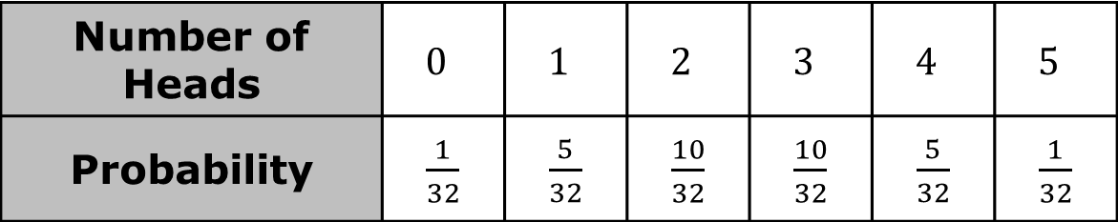
14.8.3 Guided Practice: Predictions in Repeated Experiments
Suppose a game is played where a fair coin is tossed 5 times.
If none of the tosses result in heads or all of the tosses result in heads, the player wins.
In all other outcomes, the player loses.
The probability distribution for the possible number of heads is shown below.
Number of Heads | $$0$$ | $$1$$ | $$2$$ | $$3$$ | $$4$$ | $$5$$
Probability | $\frac{1}{32}$ | $\frac{5}{32}$ | $\frac{10}{32}$ | $\frac{10}{32}$ | $\frac{5}{32}$ | $\frac{1}{32}$
volume 2, pg. 351

Slide 12
What is the probability that a player wins on their first game?
What is the probability that a player loses on their first game?
volume 2, pg. 351

Slide 13
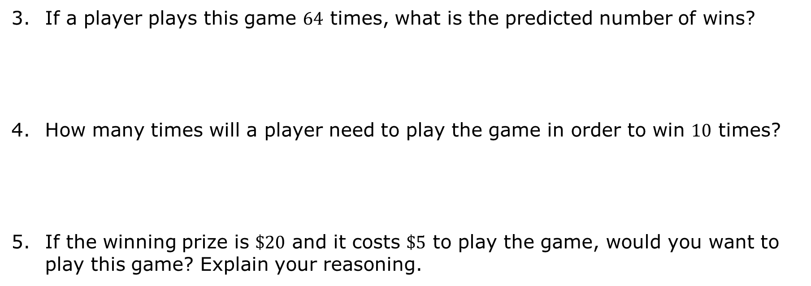
If a player plays this game $64$ times, what is the predicted number of wins?
How many times will a player need to play the game in order to win $10$ times?
If the winning prize is $\$20$ and it costs $\$5$ to play the game, would you want to play this game? Explain your reasoning.
volume 2, pg. 352

Slide 14

Your Turn
volume 2, pg. 352

Slide 15
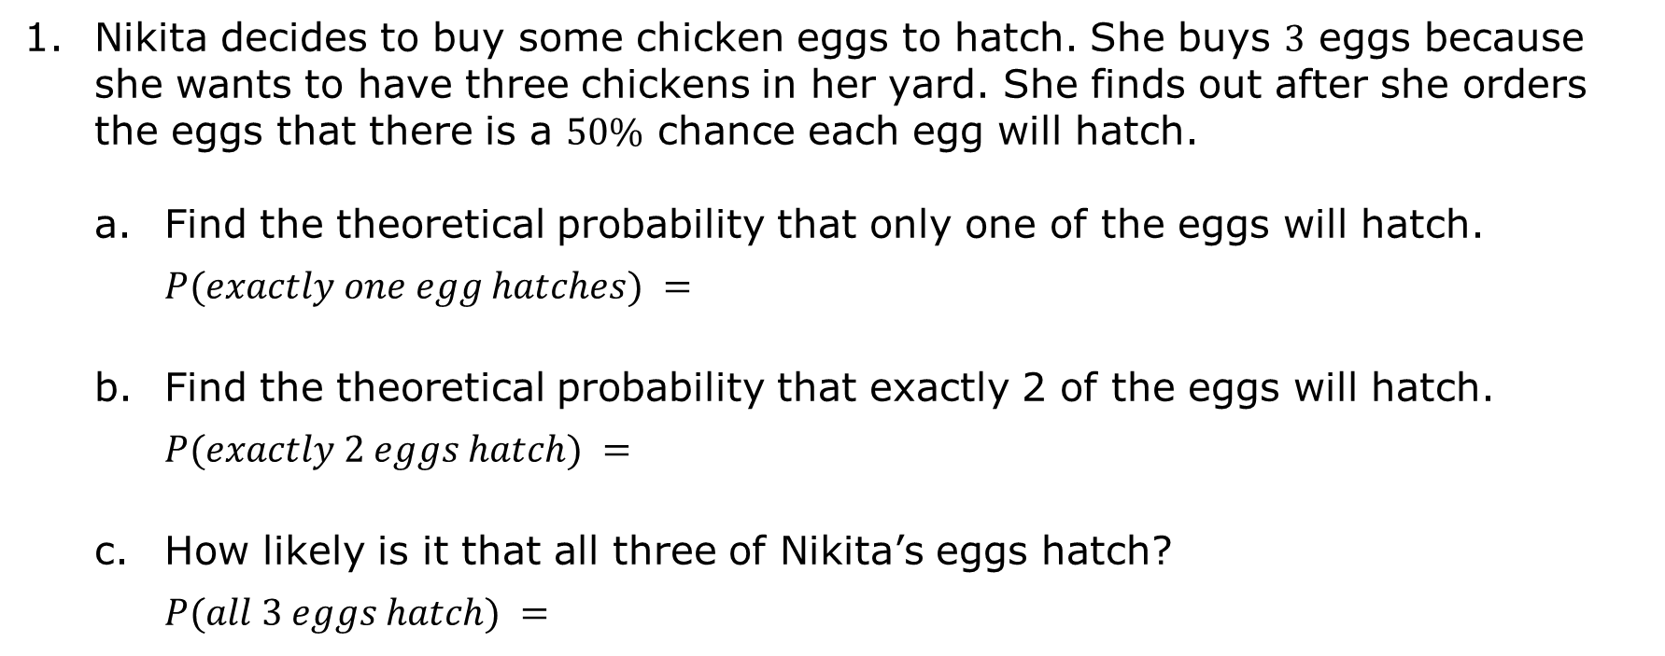
14.8.4 Your Turn!
Nikita decides to buy some chicken eggs to hatch. She buys 3 eggs because she wants to have three chickens in her yard. She finds out after she orders the eggs that there is a 50% chance each egg will hatch.
Find the theoretical probability that only one of the eggs will hatch.
$P(exactly one egg hatches) =$
Find the theoretical probability that exactly 2 of the eggs will hatch.
$$P(exactly 2 eggs hatch) =$$
How likely is it that all three of Nikita’s eggs hatch?
$$P(all 3 eggs hatch) =$$
volume 2, pg. 352

Slide 16
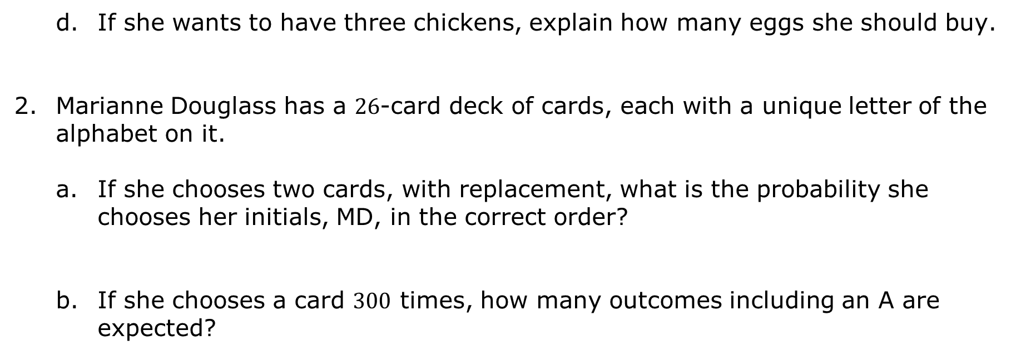
If she wants to have three chickens, explain how many eggs she should buy.
Marianne Douglass has a $26$-card deck of cards, each with a unique letter of the alphabet on it.
If she chooses two cards, with replacement, what is the probability she chooses her initials, MD, in the correct order?
If she chooses a card $300$ times, how many outcomes including an A are expected?
volume 2, pg. 353

Slide 17
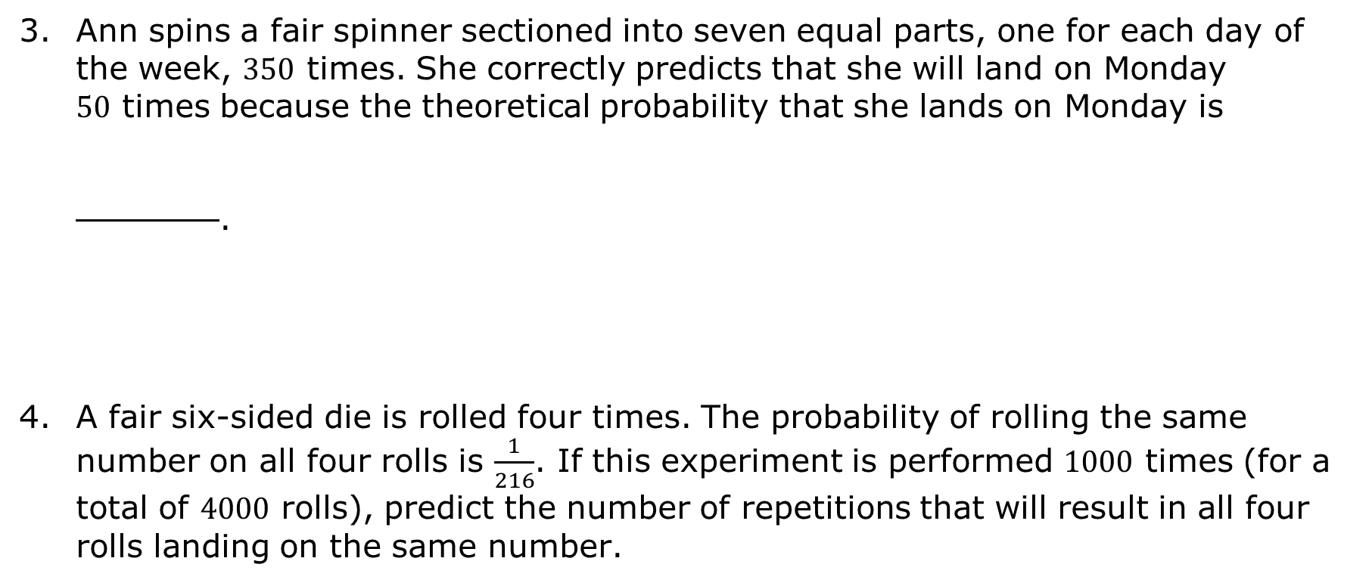
Ann spins a fair spinner sectioned into seven equal parts, one for each day of the week, $350$ times. She correctly predicts that she will land on Monday $50$ times because the theoretical probability that she lands on Monday is
.
A fair six-sided die is rolled four times. The probability of rolling the same number on all four rolls is $\frac{1}{216}$. If this experiment is performed $1000$ times (for a total of $4000$ rolls), predict the number of repetitions that will result in all four rolls landing on the same number.
volume 2, pg. 353

Slide 18

Wrap-Up
volume 2, pg. 354

Slide 19
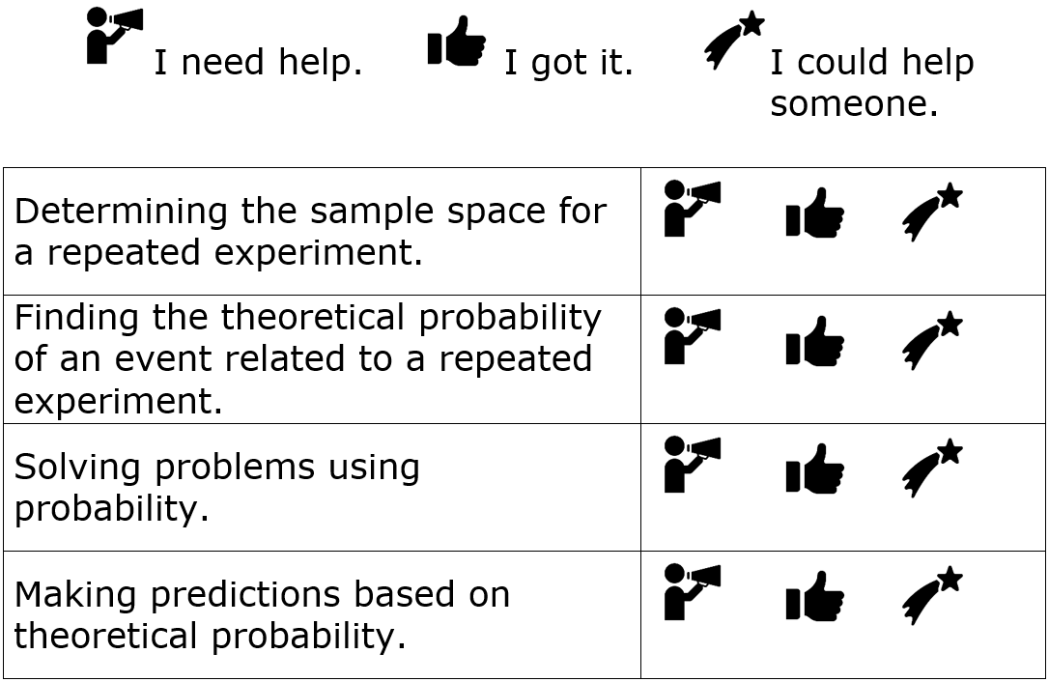
14.8.5 Wrap-Up: Reflection
Circle the icon that best describes your understanding of each concept.
volume 2, pg. 354

